Slide 1
Brief History of Food Laws & Regulations in the U.S.
John Khouryieh, PhD
Food Laws & Regulations
Western Kentucky University

Slide 2
Why Do We Have Food Laws?
People have been concerned about food safety.
Governments want to protect consumers against economic fraud and to prevent against the sale of unsafe food.

Slide 3
1862
President Lincoln appoints a chemist, Charles M. Wetherill, to serve in the new Department of Agriculture (USDA).
This was the beginning of the Bureau of Chemistry, the predecessor of the Food and Drug Administration.

Slide 4
1880
Peter Collier, chief chemist, USDA, recommends passage of a national food and drug law, following his own food adulteration investigations.
The bill was defeated, but during the next 25 years more than 100 food and drug bills were introduced in Congress.

Slide 5
1883 & 1896
1883
The first federal food protection law was enacted by Congress to prevent the importation of adulterated tea.
1896
The oleo-margarine statute was passed because dairy farmers and the dairy industry objected to the sale of adulterated butter and fats colored to look like butter.

Slide 6
The “Poison Squad”
In 1883, Dr. Harvey W. Wiley became the chief chemist of the Bureau of Chemistry.
Dr. Wiley expanded the research and testing on effects of food additives such as formic acid and formaldehyde on human heath using live volunteers.
The additives sickened the volunteers.

Slide 7
The “Poison Squad” (Cont’d)
The study which was named “Poison Squad” by a newspaper reporter who brought the the food additive issue to the attention of American consumers.
The findings of the study let President Roosevelt to recommend that a law to be enacted to regulate the interstate commerce of adulterated and misbranded foods, drinks and drugs.

Slide 8
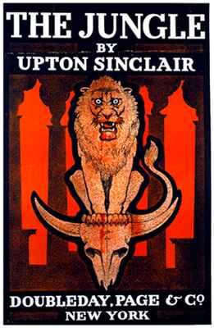
Upton Sinclair's Book The Jungle (1905)
Upton Sinclair's book The Jungle, a vivid portrait of intolerable human cruelty and unsanitary conditions in Chicago meatpacking factory, caused public outrage.

Slide 9
The Jungle (1905)
Led President Theodore Roosevelt to call for government regulations of the food industry, and laid the groundwork for the passage of the Federal Meat Inspection Act and the Federal Food and Drug Act in 1906.

Slide 10
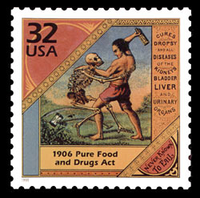
Pure Food and Drug Act of 1906
It prohibits interstate commerce in misbranded and adulterated foods, drinks and drugs.

Slide 11
Weaknesses of the Pure Food and Drug Act include:
Lack of legal standards (description) for foods,
Lack of authority to inspect food and drug warehouses,
Inability to restrict the interstate shipment of a food that a naturally contain poison, and
Lack of jurisdiction over false or misleading claims made on food.

Slide 12
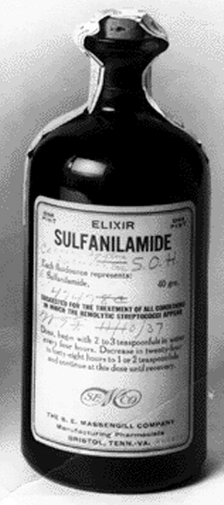
Elixir of Sulfanilamide Tragedy (1937)
Sulfanilamide, new sulfa drugs, was used to treat strep throat.
The drug was mixed with the poisonous diethylene glycol to increase its palatability.
killed 107 persons, many of whom are children.

Slide 13
Elixir of Sulfanilamide Case (1937)
The manufacturer admitted they performed no safety tests.
The tragedy spurred legislative action to establish drug safety before marketing and to enact the Federal Food, Drug, and Cosmetic Act of 1938.

Slide 14
Food Additives Problems
In 1950s, concerns over synthetic food additives, pesticides, and cancer were high.
In 1951, a House committee chaired by James Delaney begin examining the safety of food additives and pesticides.
As a result, the 1958 Food Additive Amendment and 1960 Color Additive Amendment to the FD&C Act were enacted.

Slide 15
Food Poisoning Outbreaks
1970s, after many outbreaks of botulism food poisoning from canned foods, the FDA issued Low-Acid Food Processing Regulations in 1973.
After deaths from cyanide placed in Tylenol capsules, the FDA issued the Tamper-Resistant Packaging regulations in 1982.

Slide 16
More High-Profile Food Recalls and Foodborne Illness Outbreaks
In 2006, fresh spinach sickened over 200.
In 2007, more than 600 people became ill from contaminated peanut butter.
In 2008, imported peppers sickened over 1,400.
In 2009, 9 deaths and hundreds of illnesses from consuming peanut paste.
In 2010, ~2000 cases of illnesses were linked to eggs from two farms in Iowa, and more than 500 million eggs were recalled.
January 4, 2011, President Obama signed the Food Safety Modernization Act (FSMA) into Law.

Slide 17
Useful Websites
Food and Drug Administration (FDA)
Food Safety and Inspection Services (FSIS) – FSIS History

